Slide 1









My Algebra - Quadratics Interactive Notebook
$$×$$
$$\frac{1}{2}$$
$$÷$$
$$+$$
$$−$$
$$\frac{3}{5}$$
$$7$$
Name
Class: 10.1
Teacher: Mr Summers
Term 1 Semester 1
$$5^{2}$$
$$\sqrt{9}$$

Slide 2
Contents
Glossary or Formula Page
Page
Date
Description
2

Slide 3
Which statement demonstrates the distributive property incorrectly?
3(x + y + z) = 3x + 3y + 3z
(a + b) c = ac + bc
(5 + x)(2 + 3x) = 10 + 15x + x² + 3x
6(3k - 4) = 18k - 24

Slide 4
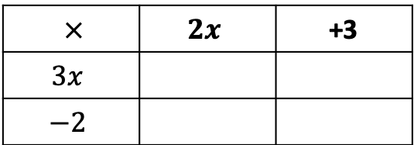



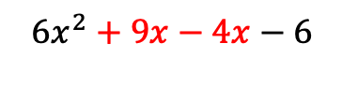
24
7
30
Date
Expanding Binomial Expressions
EQ – What techniques can I use to expand expressions with brackets and how do I factorise binomial and quadratic equations?
There are two main ways to expand expressions with brackets: The table method and the FOIL method
How do I use the table method?
Expand $(2x+3)(3x−2)$
$×$ | $$2x$$ | +3
$$3x$$
$$−2$$
6x²
+ 9x
-4x
- 6
}
$$6x^{2}+9x−4x−6$$
Collect like terms
=$6x^{2}+5x−6$
How do I use the FOIL method?
First
Outside
Inner
Last
$$\left(2x+3\right)\left(3x−2\right)$$
=
6x²
-4x
+ 9x
- 6
= 6x² + 5x - 6

Slide 5
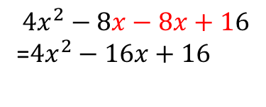
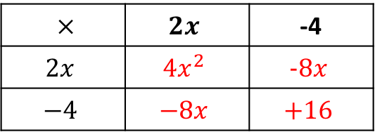
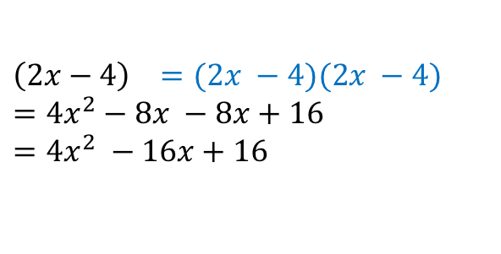
24
7
30
Date
Expanding Binomial Expressions
EQ – What techniques can I use to expand expressions with brackets and how do I factorise binomial and quadratic equations?
Expand (2x - 4)²
Using the table method
$×$ | $$2x$$ | -4
$$2x$$ | $$4x^{2}$$ | $$−8x$$
$$−4$$ | $$−8x$$ | $$+16$$
$$4x^{2}−8x−8x+16$$
=$4x^{2}−16x+16$
Using the FOIL method
First
Outside
Inner
Last
$$\left(2x−4\right) =(2x −4)(2x −4)$$
$$=4x^{2}−8x −8x+16$$
$$=4x^{2} −16x+16$$
²

Slide 6
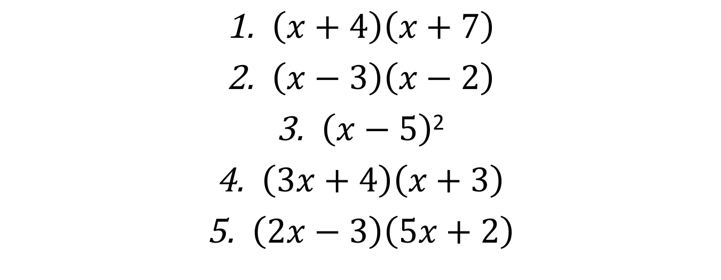
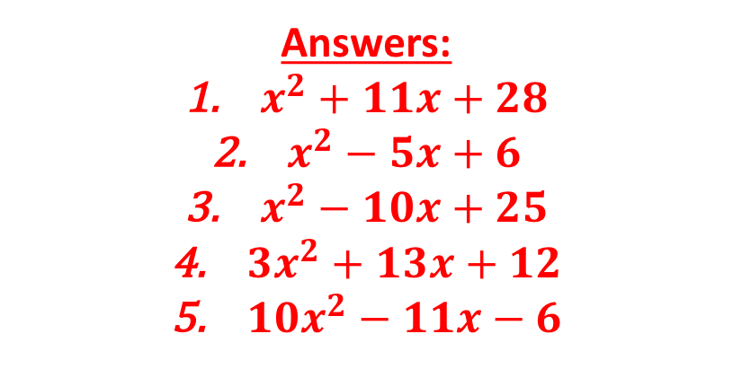
Expand these brackets:
$\left(x+4\right)\left(x+7\right)$
$\left(x−3\right)\left(x−2\right)$
$\left(x−5\right)$²
$\left(3x+4\right)\left(x+3\right)$
$\left(2x−3\right)\left(5x+2\right)$
Answers:
$x^{2}+11x+28$
$x^{2}−5x+6$
$x^{2}−10x+25$
${3x}^{2}+13x+12$
${10x}^{2}−11x−6$

Slide 7
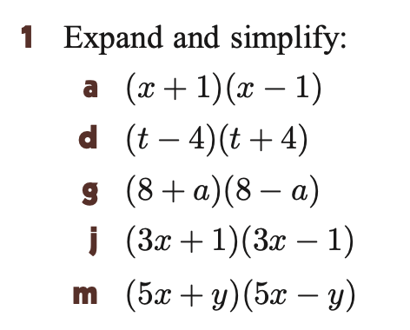
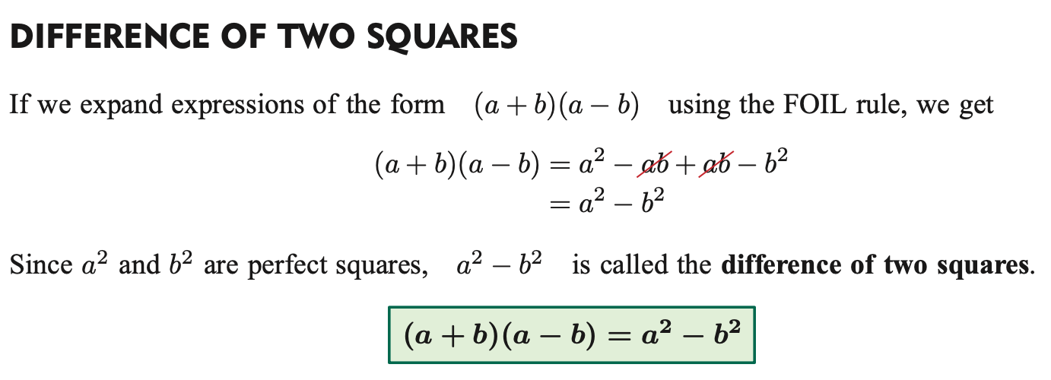
Now try these:
What do you notice? Can you write a rule for these types of expansions?

Slide 8


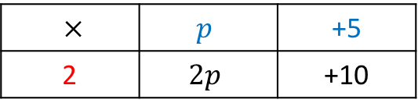

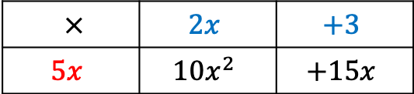

24
7
30
Date
Factorising Expressions
EQ – What techniques can I use to expand expressions with brackets and how do I factorise binomial and quadratic equations?
What is the HCF?
HCF – Highest Common factor
How do I find
the HCF using the box method?
Factorise $2p+10$
Divide terms by HCF
Find the HCF of both terms (in this case 2)
$×$ | $$p$$ | +5
2 | $$2p$$ | +10
Write the expression using brackets
$$2(p+5)$$
Factorise $10x^{2}+15x$
Find the HCF of both terms (in this case 5x)
$×$ | $$2x$$ | $$+3$$
$$5x$$ | $$10x^{2}$$ | $$+15x$$
$$10x^{2}+15x=5x(2x+3)$$

Slide 9
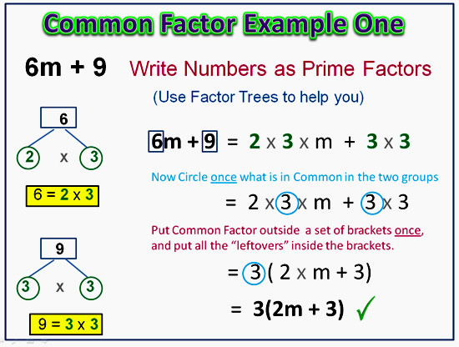
24
7
30
Date
Expanding Binomial Expressions
EQ – What techniques can I use to expand expressions with brackets and how do I factorise binomial and quadratic equations?
How do I find
the HCF using a factor tree?

Slide 10
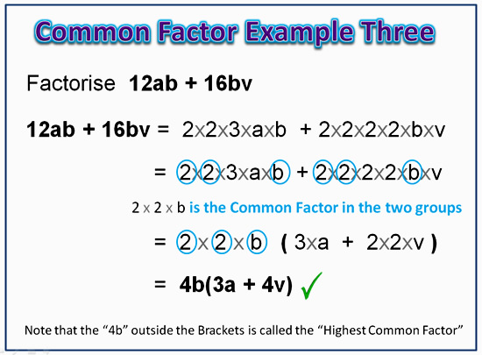
24
7
30
Date
Expanding Binomial Expressions
EQ – What techniques can I use to expand expressions with brackets and how do I factorise binomial and quadratic equations?

Slide 11

Factorise the following:
$4xy+8x$
$−10ab −5$
$15ab −25abc$
²
³
³
²

Slide 12



24
7
30
Date
Expanding Binomial Expressions
EQ – What techniques can I use to expand expressions with brackets and how do I factorise binomial and quadratic equations?
How do we factorise quadratic equations?
Regardless of the method we use, the steps are the same. Take:
We need to find two numbers that multiply to +8 and add to +6
List all factors of 8:
$$x^{2}+6x+8$$
+1 and +8
-1 and -8
+2 and +4
-2 and -4
Answer: $(x+2)(x+4)$
Can you now factorise $x^{2}+9x+20?$
Answer: $(x+5)(x+4)$

Slide 13



24
7
30
Date
Expanding Binomial Expressions
EQ – What techniques can I use to expand expressions with brackets and how do I factorise binomial and quadratic equations?
Factorise $x^{2}−10x+16$
Pairs of numbers that multiply to make “+16”:
+1 and +16
-1 and -16
+2 and +8
-2 and -8
+4 and +4
-4 and -4
Which pair adds to make “-10”?
Answer: $(x−2)(x−8)$
Can you now factorise $x^{2}−7x+6?$
Answer: $(x−1)(x−6)$

Slide 14

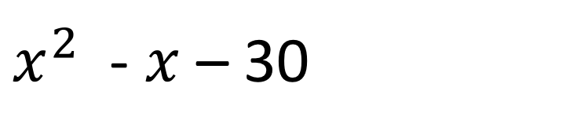
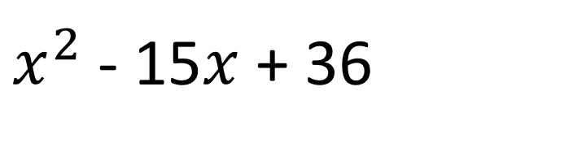

Factorising Method
On your whiteboards, factorise the following quadratic equations:
$x^{2}$ + 12$x$ + 32
$x^{2}$ + 6$x$ + 9
$x^{2}$ - 15$x$ + 36
$x^{2}$ - 7$x$ – 44 = 0
$x^{2}$ - $x$ – 30
$x^{2}$ + 6$x$ – 27 = 0

Slide 15
On the LHS of your INB...
(1)Factorise the following quadratic equations
(a) x² - 6x + 8
(b) x² + x - 12 = 0
(c) x² - 7x - 30 = 0
(d) 3x² + 18x + 24 = 0
(2) I think of a number. I add 6 to it. I multiply the result by the original number and subtract 5. Write this down as a factorised form

Slide 16
Notes Review
24, 7 ,30
Date
Title
Essential question
Notes complete
Notes complete with colour and diagrams
Questions completed
Contents page filled in
Formula page filled in

Slide 17
Homework
Review your notes and write a summary answering the essential question.

